Slide 1
Microsoft UI Kit

Slide 2
Guide to interface design
Testing of the interface
Organization of screen elements
Navigation and flow
Pleasant visual composition
Typography
Key procedure
Data output

Slide 3
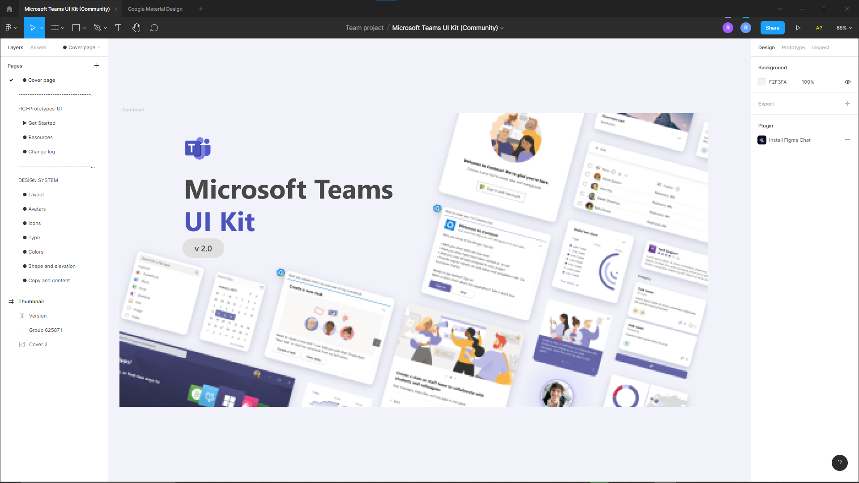
Testing of the interface

Slide 4
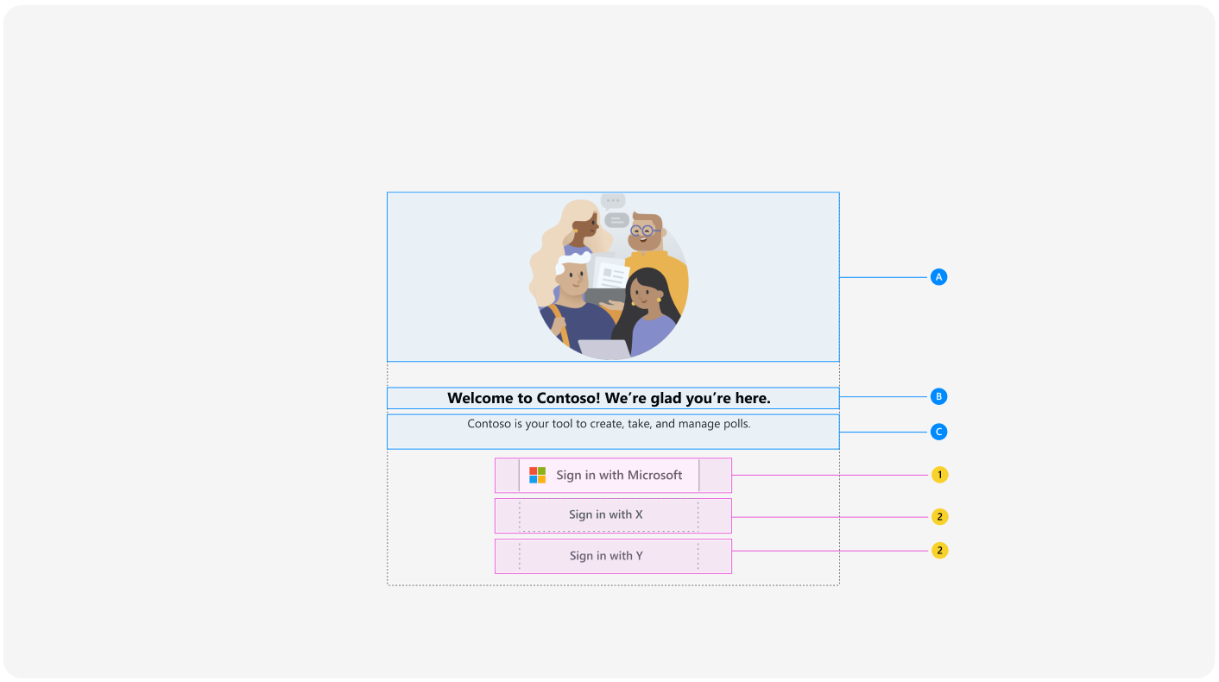
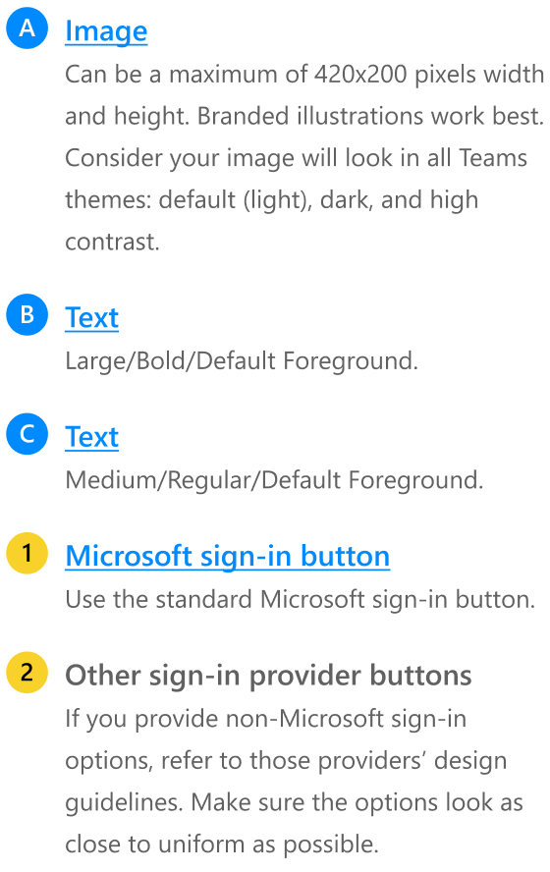
Organisation of screen elements / Sign In

Slide 5
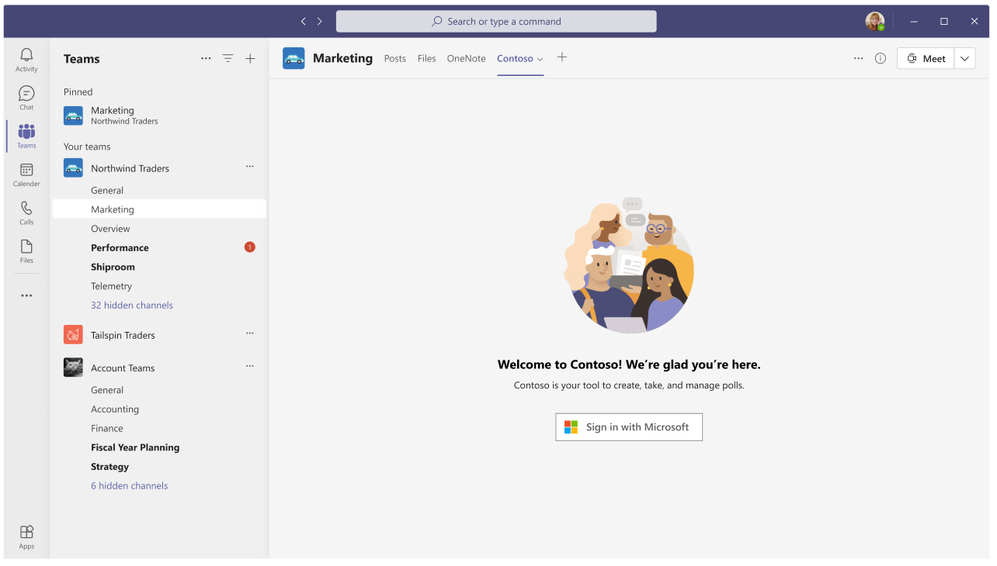
Navigation flows / Sign in

Slide 6
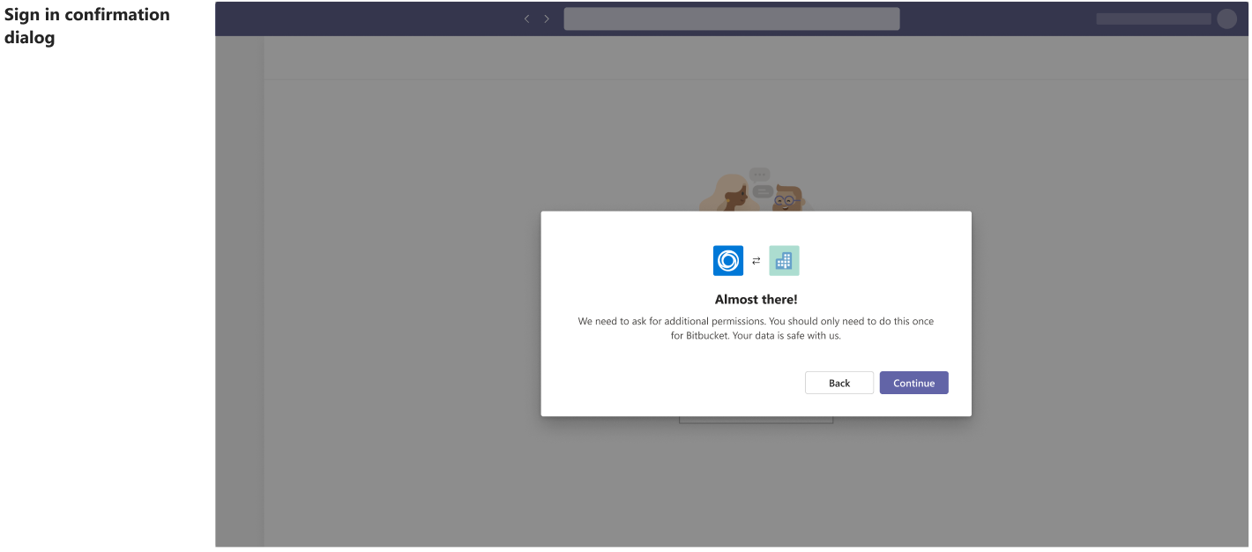
Navigation flows / Sign in

Slide 7
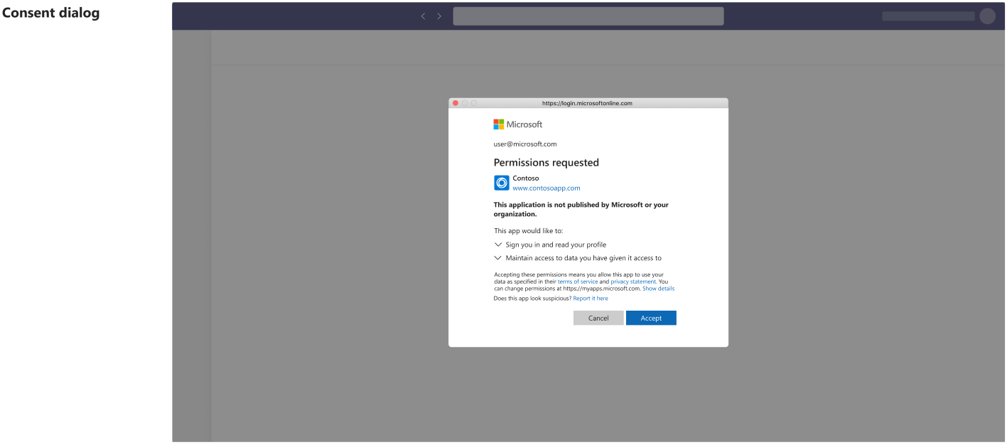
Navigation flows / Sign in

Slide 8
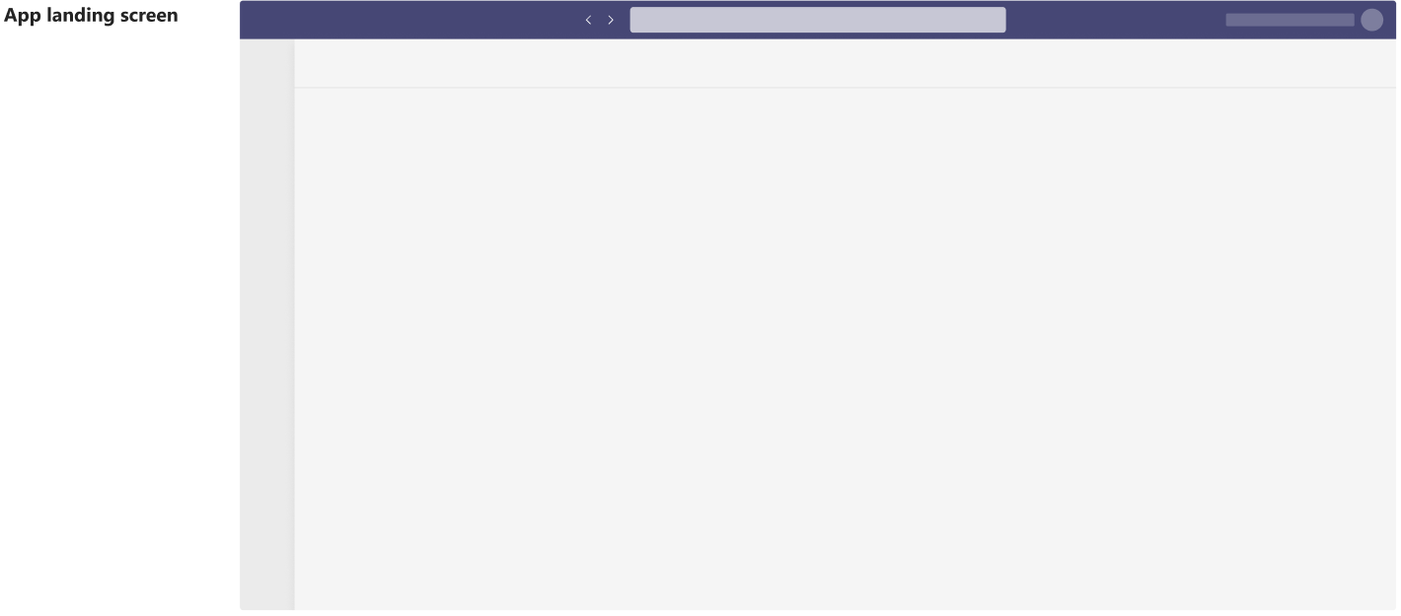
Navigation flows / Sign in

Slide 9
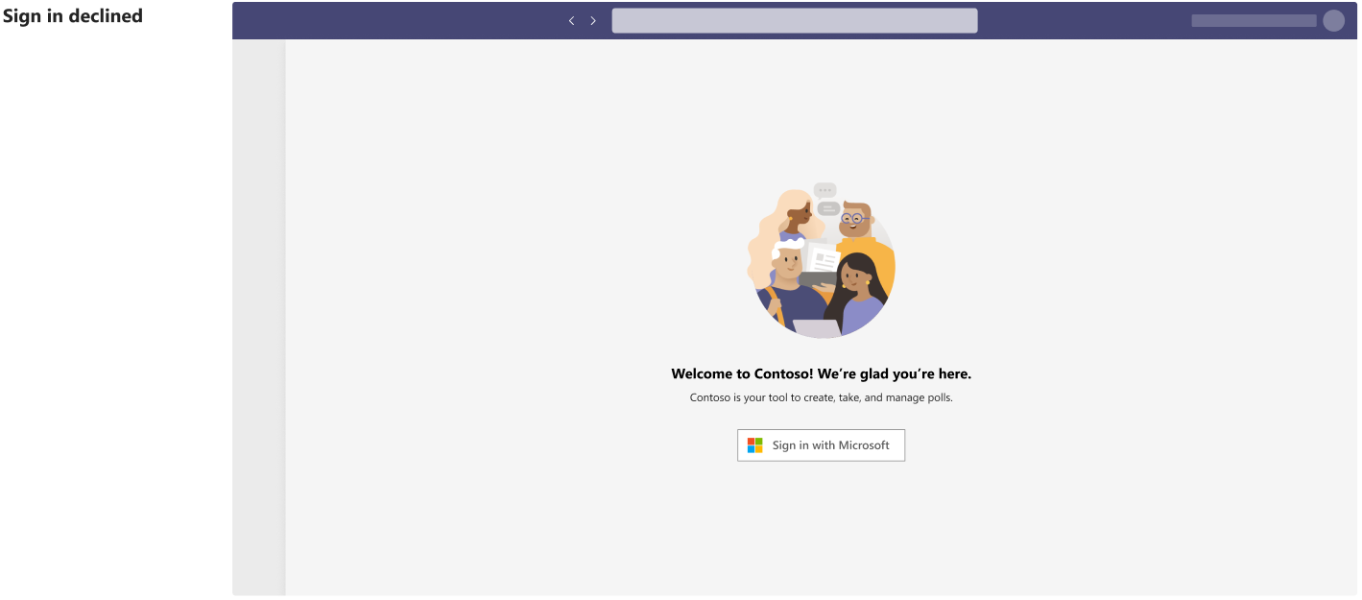
Navigation flows / Sign in

Slide 10
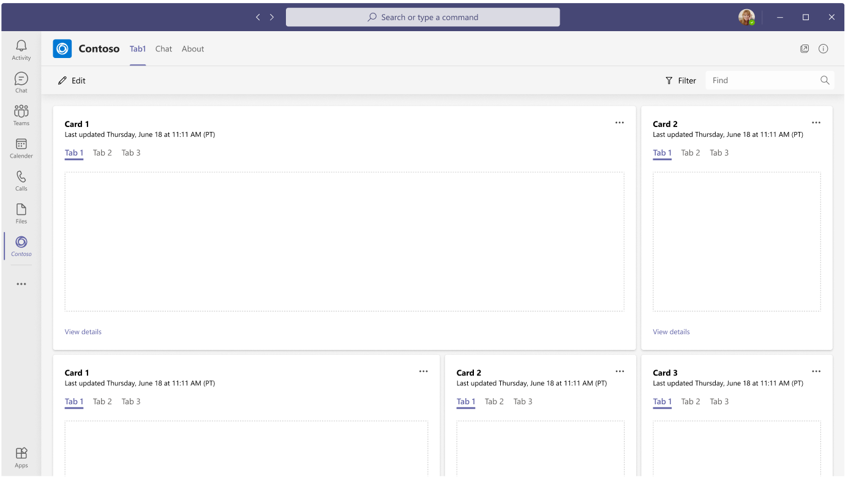

Organisation of screen elements / Dashboard

Slide 11
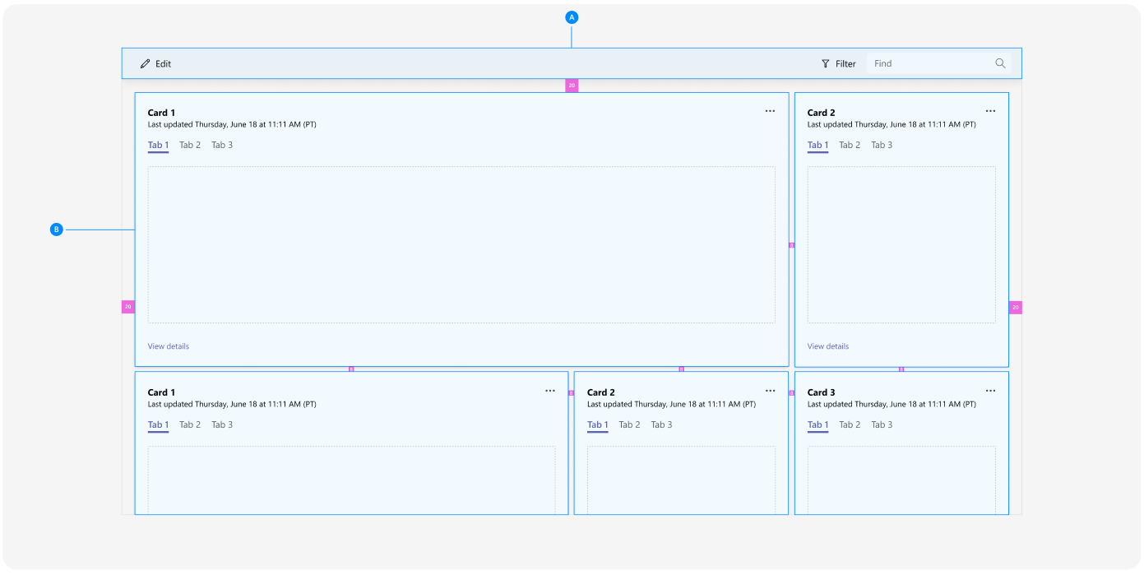
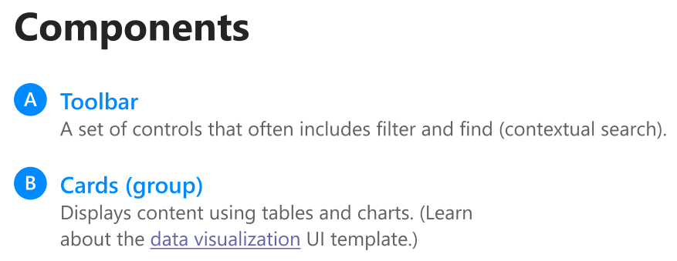
Organisation of screen elements / Dashboard

Slide 12
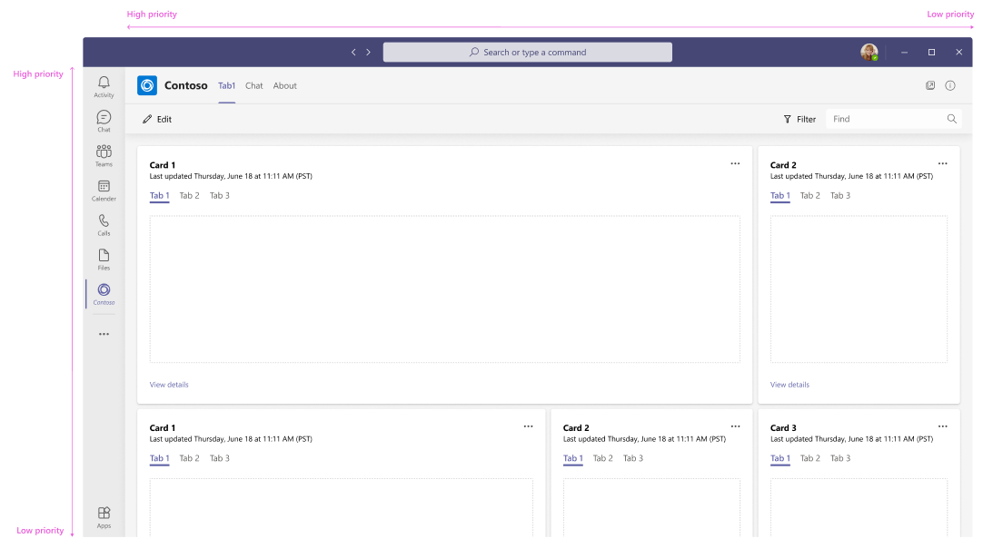
Organisation of screen elements / Dashboard
Prioritize content from left to right and top to bottom

Slide 13
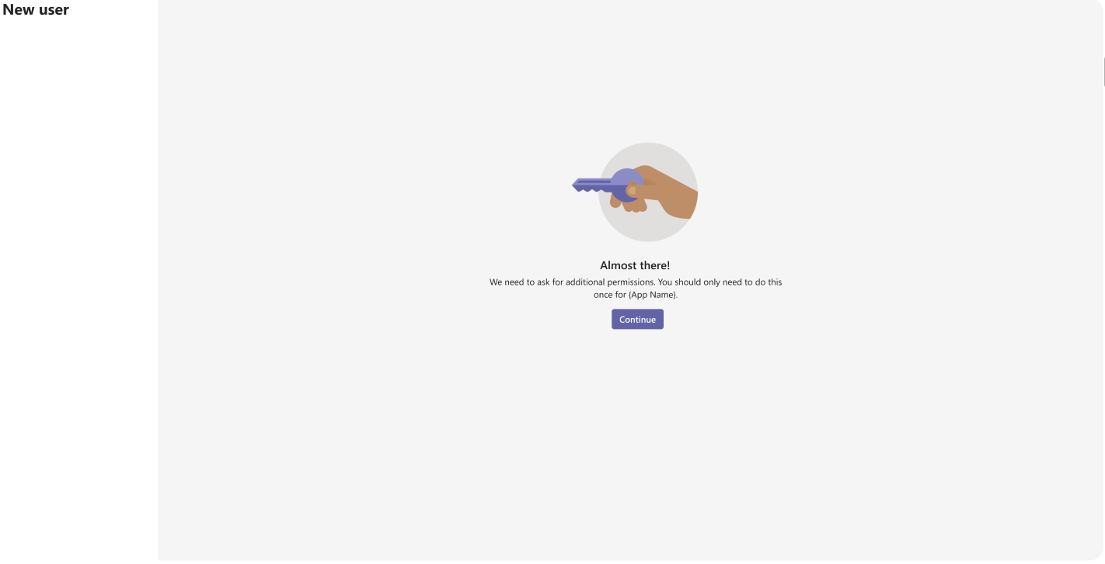
Navigation flows / Dashboard

Slide 14
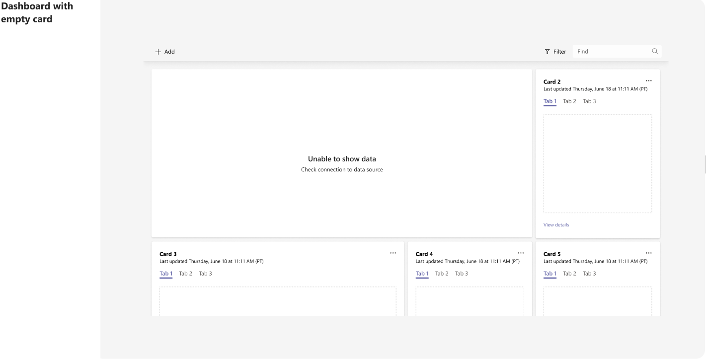
Navigation flows / Dashboard

Slide 15
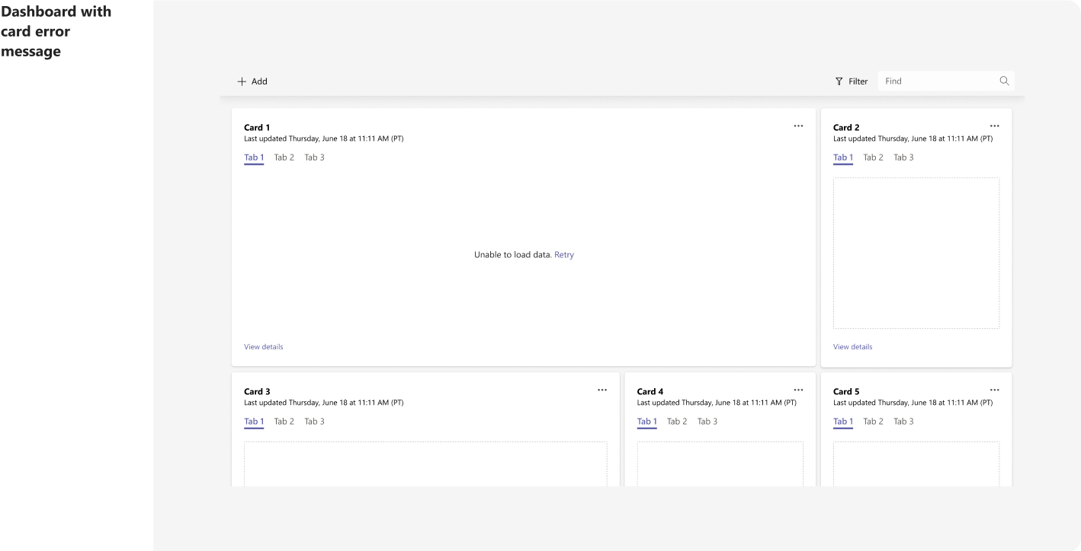
Navigation flows / Dashboard

Slide 16
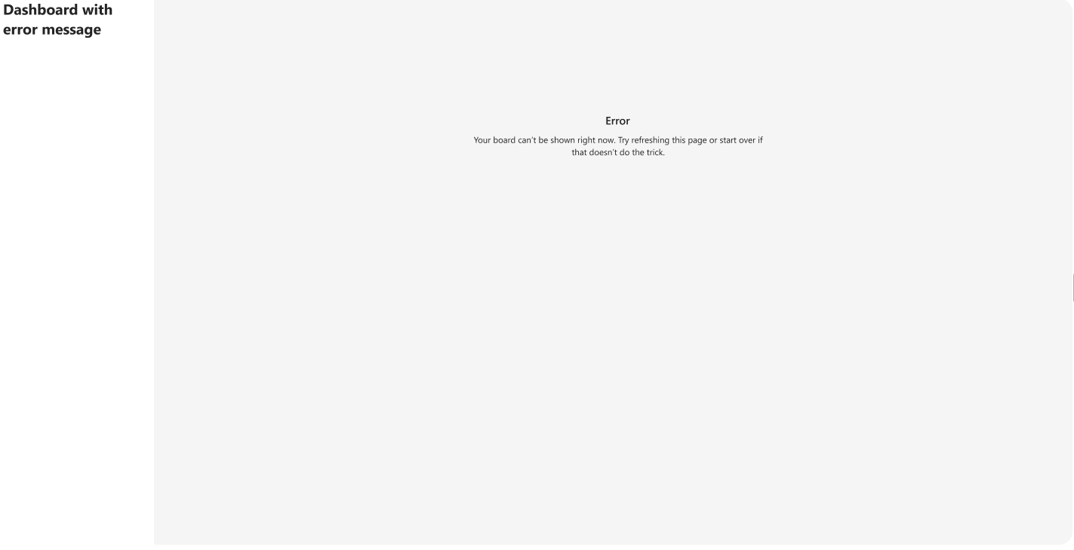
Navigation flows / Dashboard

Slide 17
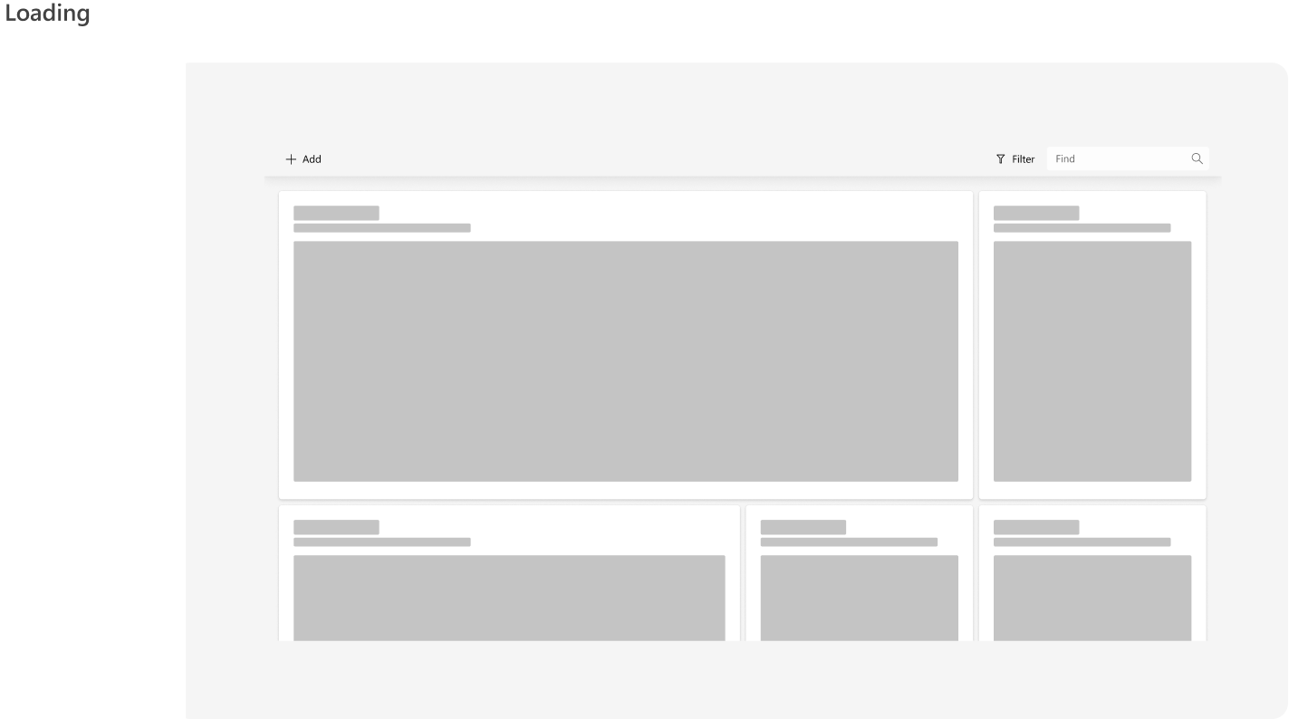
Navigation flows / Dashboard

Slide 18
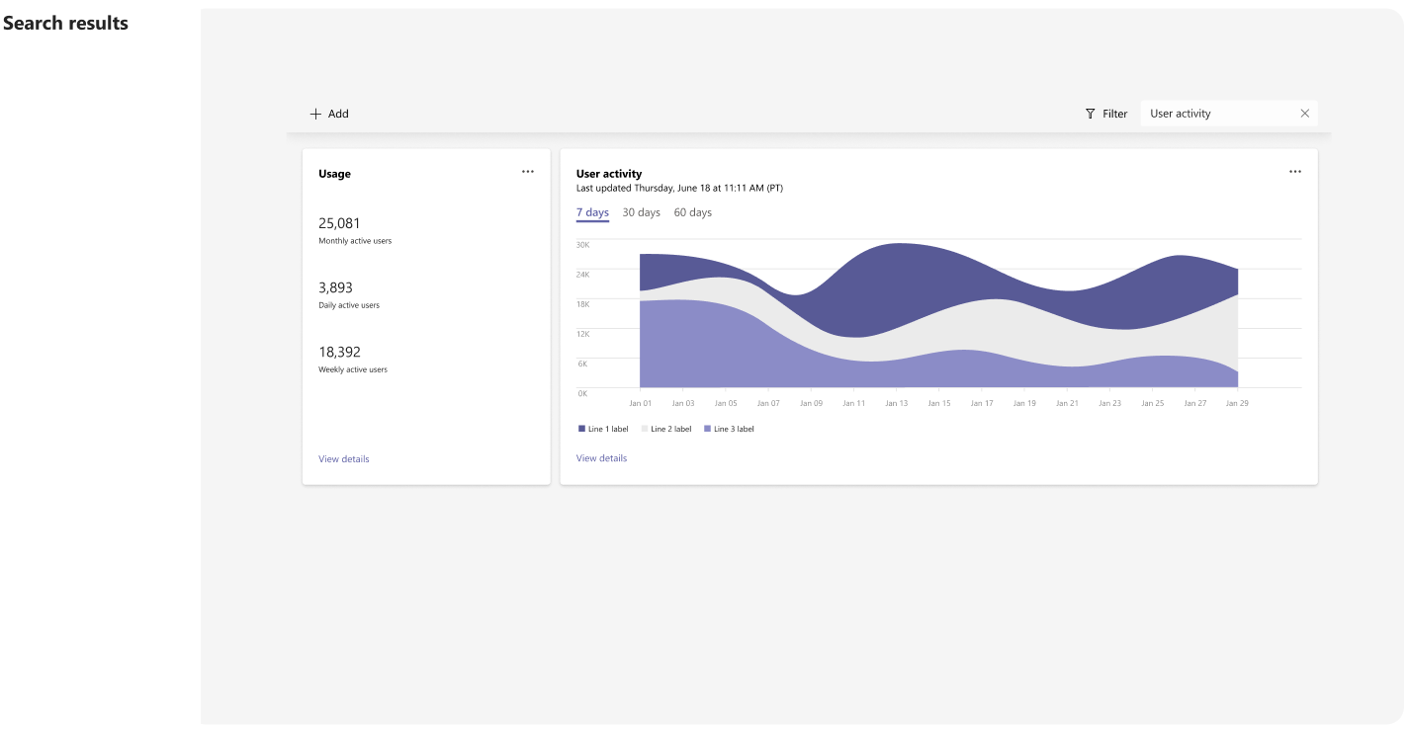
Navigation flows / Dashboard

Slide 19
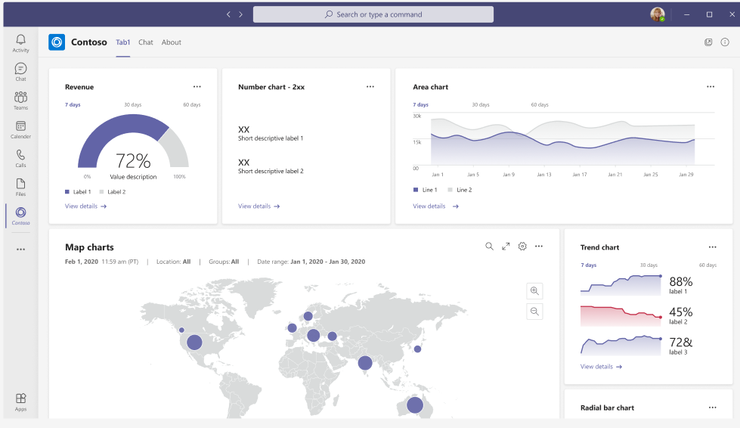
Navigation flows / Dashboard

Slide 20
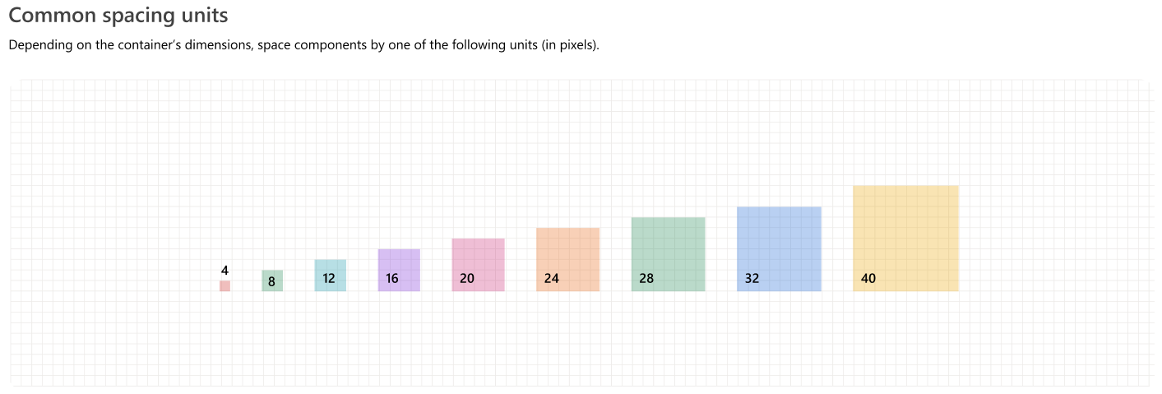
Pleasant visual composition

Slide 21

Pleasant visual composition

Slide 22
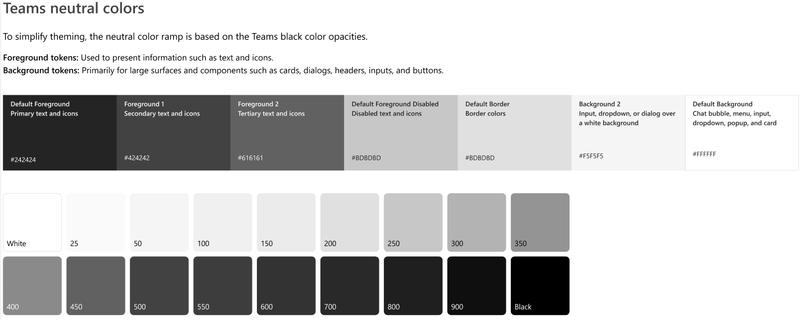
Pleasant visual composition

Slide 23
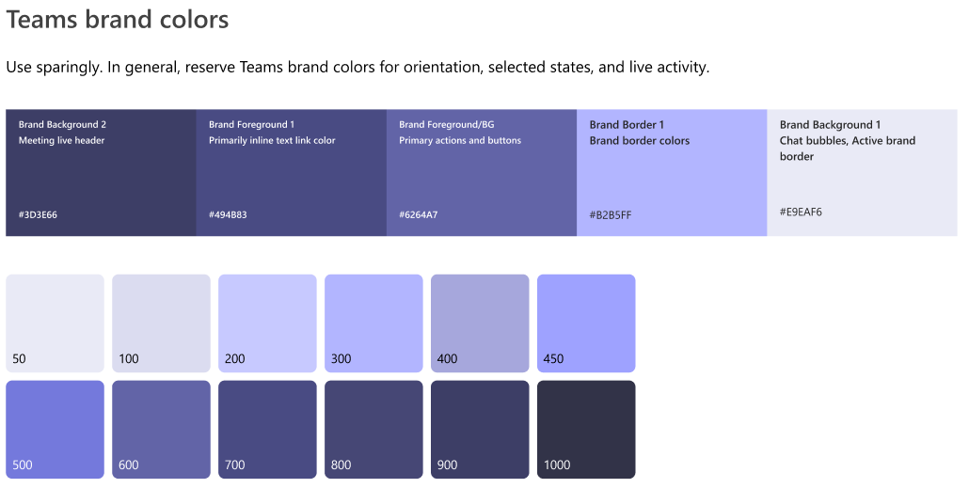
Pleasant visual composition

Slide 24
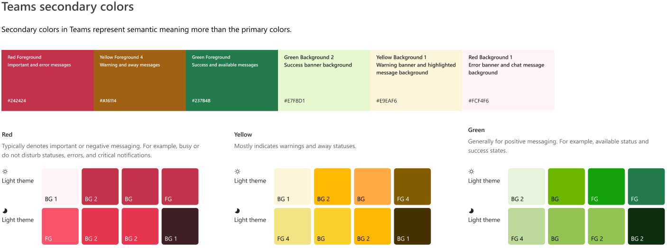
Pleasant visual composition

Slide 25

Pleasant visual composition

Slide 26

Pleasant visual composition

Slide 27
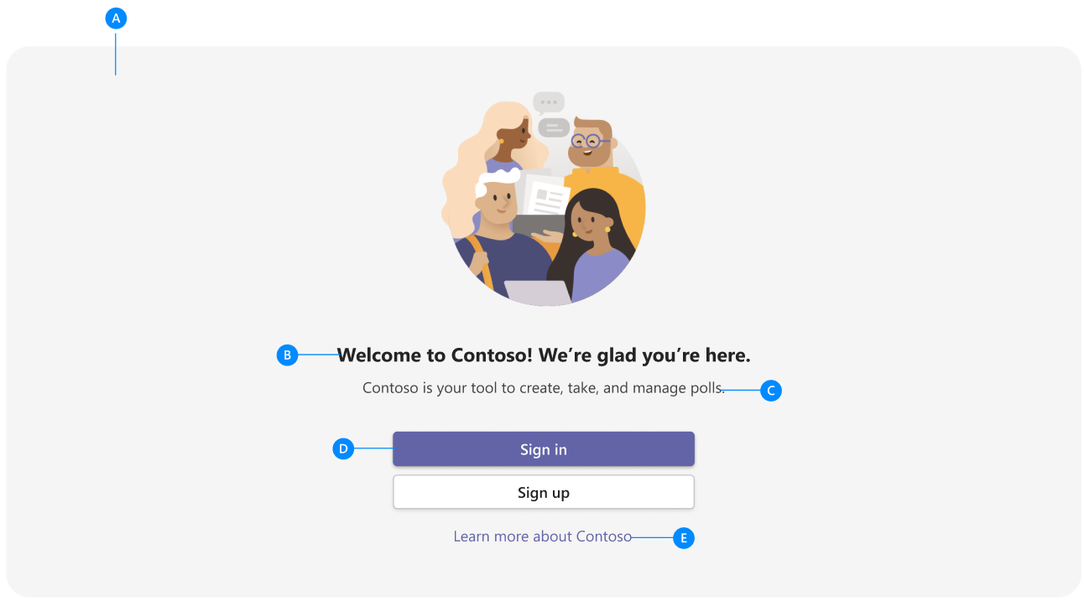
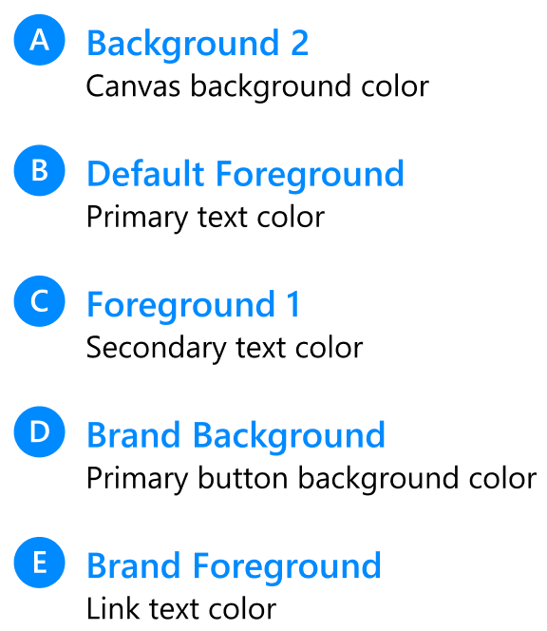
Pleasant visual composition

Slide 28

Pleasant visual composition

Slide 29

Pleasant visual composition

Slide 30
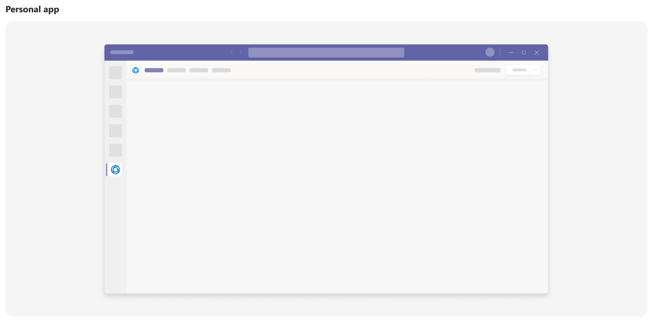

Slide 31

Typography

Slide 32


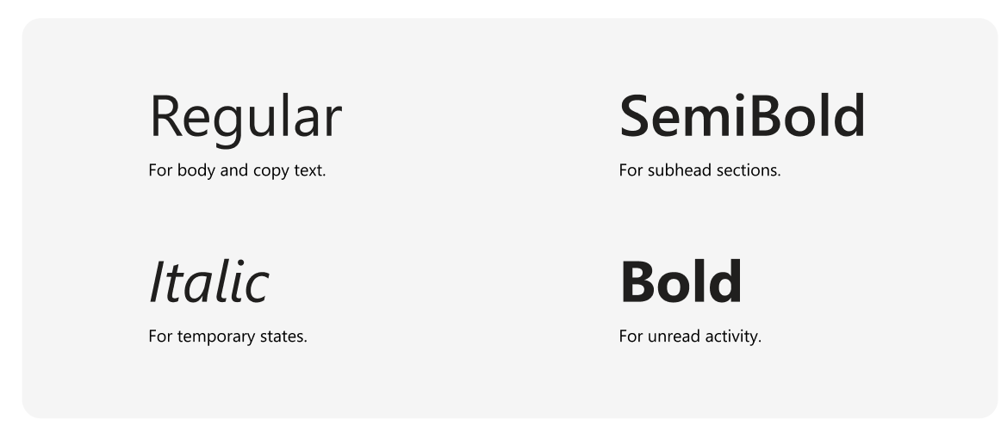
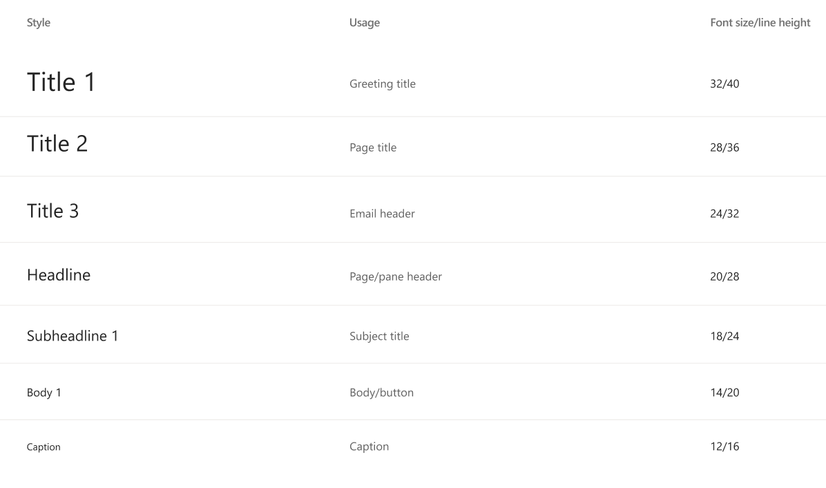
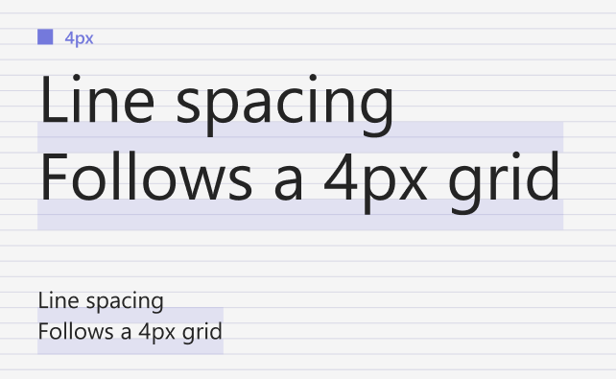

Slide 33
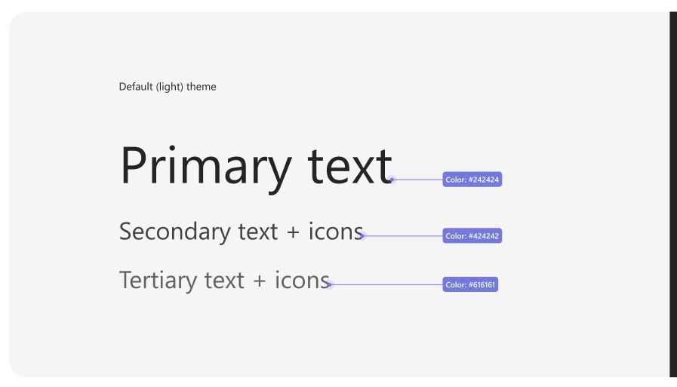
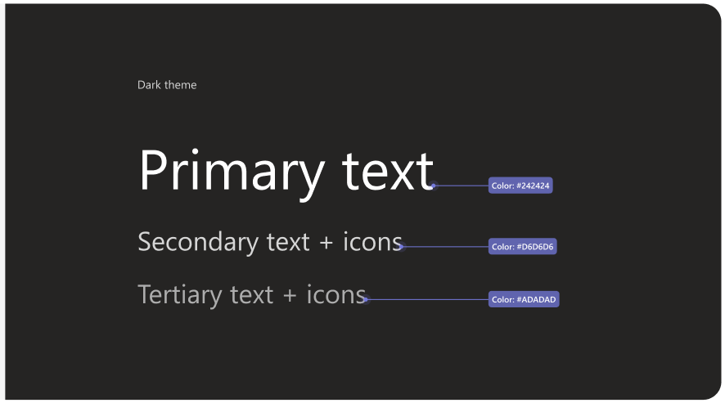
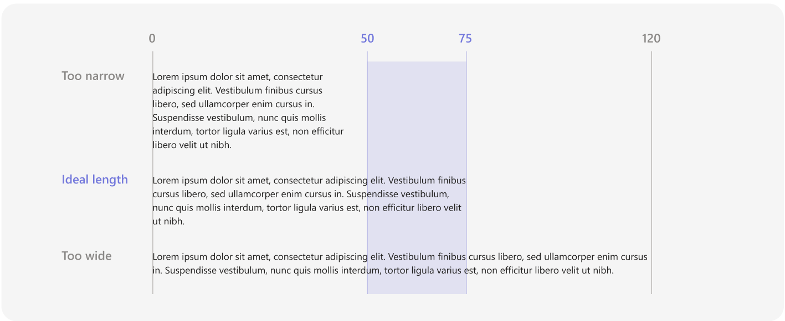
Typography Usage

Slide 34
Key procedure

Slide 35
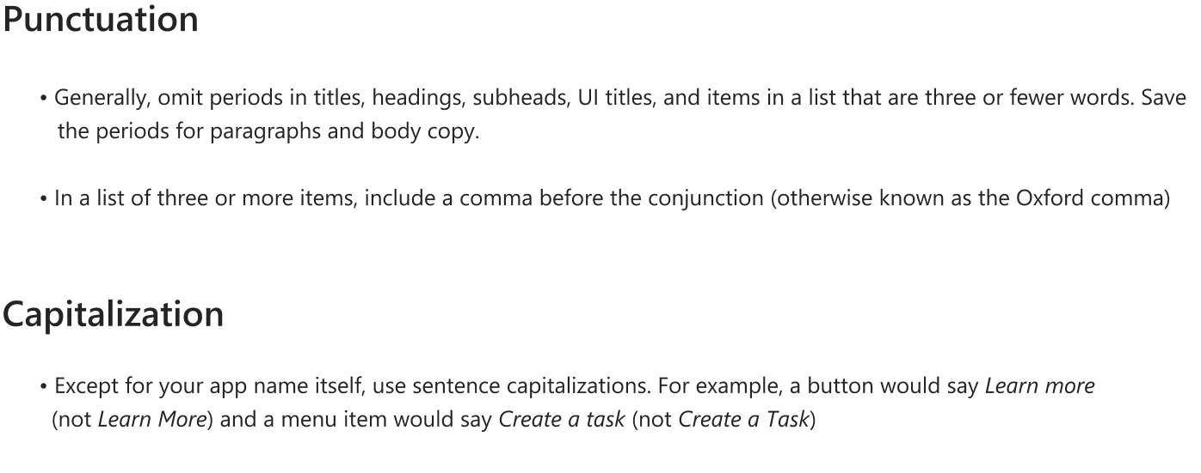
Data output

Slide 36
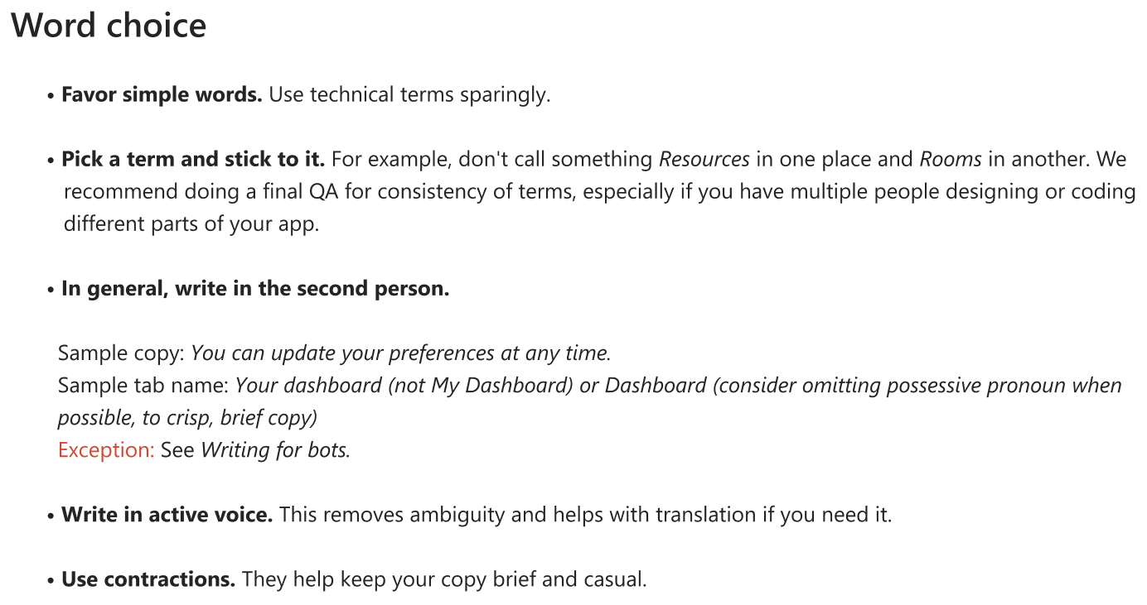
Data output

Slide 37
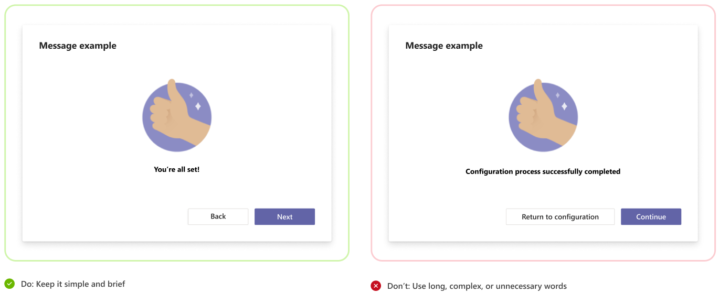
Data output

Slide 38

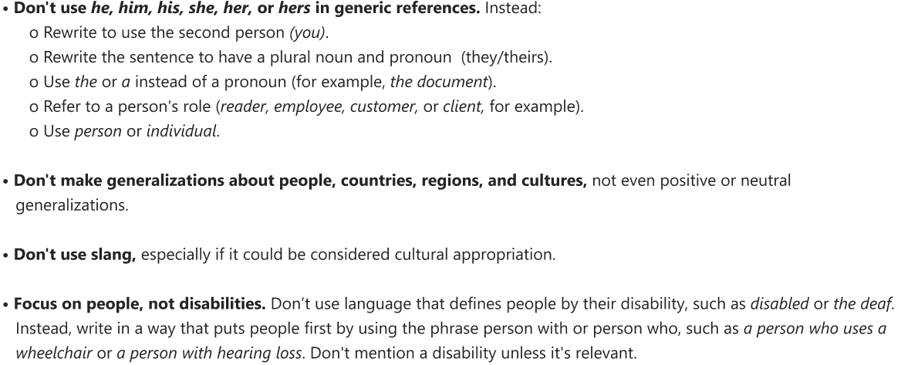
Data output

Slide 39

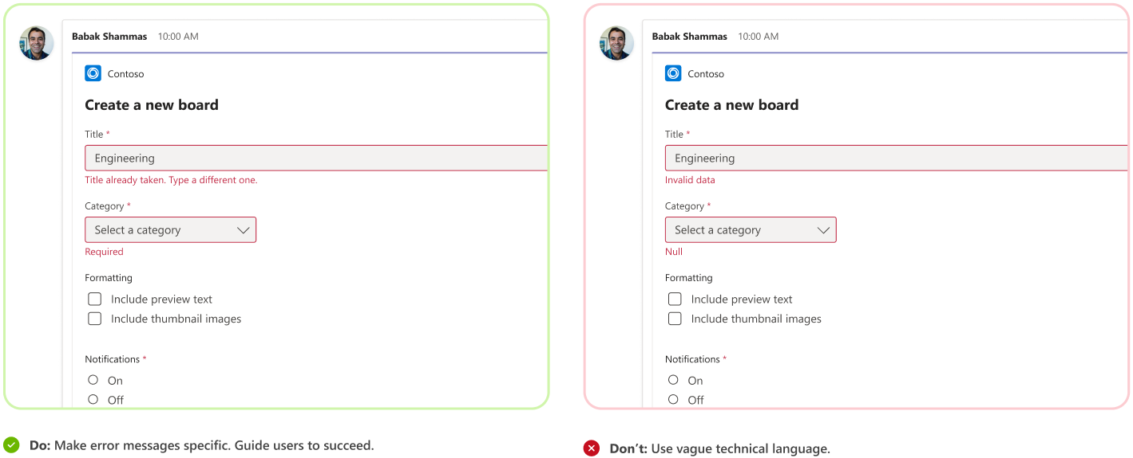
Data output

Slide 40


Data output

